Slide 1


Multi-Tier Cloud Architecture Design for SONYC RAG Application
Team Members
Abdullah
Muhammad Azfar
Muhammad Affan
Muhammad Hamza Haider
Muhammad Muhad
Cloud Computing (SE-315)
CEA Assignment
Class: BESE29-A
Complex Engineering Activity
Military College of Signals, NUST

Slide 2




Executive Summary
SONYC Application Overview
Production vs Development
A production-ready Retrieval-Augmented Generation (RAG) chatbot application deployed on AWS cloud infrastructure.
Single m7i-flex
EC2
Multiple t3 instances
Availability Zone
Single (eu-north-1b)
Multi-AZ
Key Highlights
db.t4g.micro, Single-AZ
RDS Database
db.t3.medium, Multi-AZ
99.9% Availability
Multi-AZ Deployment
Target uptime
High availability
Broad access (dev config)
Security
Least privilege, restricted
Production Security
Auto-Scaling
Defense-in-depth
100-1,000+ users
Network
Simple VPC
Multi-tier (ALB, CloudFront)

Slide 3




High-Level Architecture Overview
Presentation Layer
• CloudFront CDN
• Next.js Frontend
• S3 Static Assets
Application Layer
• Application Load Balancer
• FastAPI Backend (Auto Scaling)
Data Layer
• RDS PostgreSQL (Multi-AZ)
• S3 Vector Stores
External Services
Figure 1: Multi-Tier Cloud Deployment Architecture
• Google AI
• HuggingFace API
• GitHub API
• Tavily Search

Slide 4
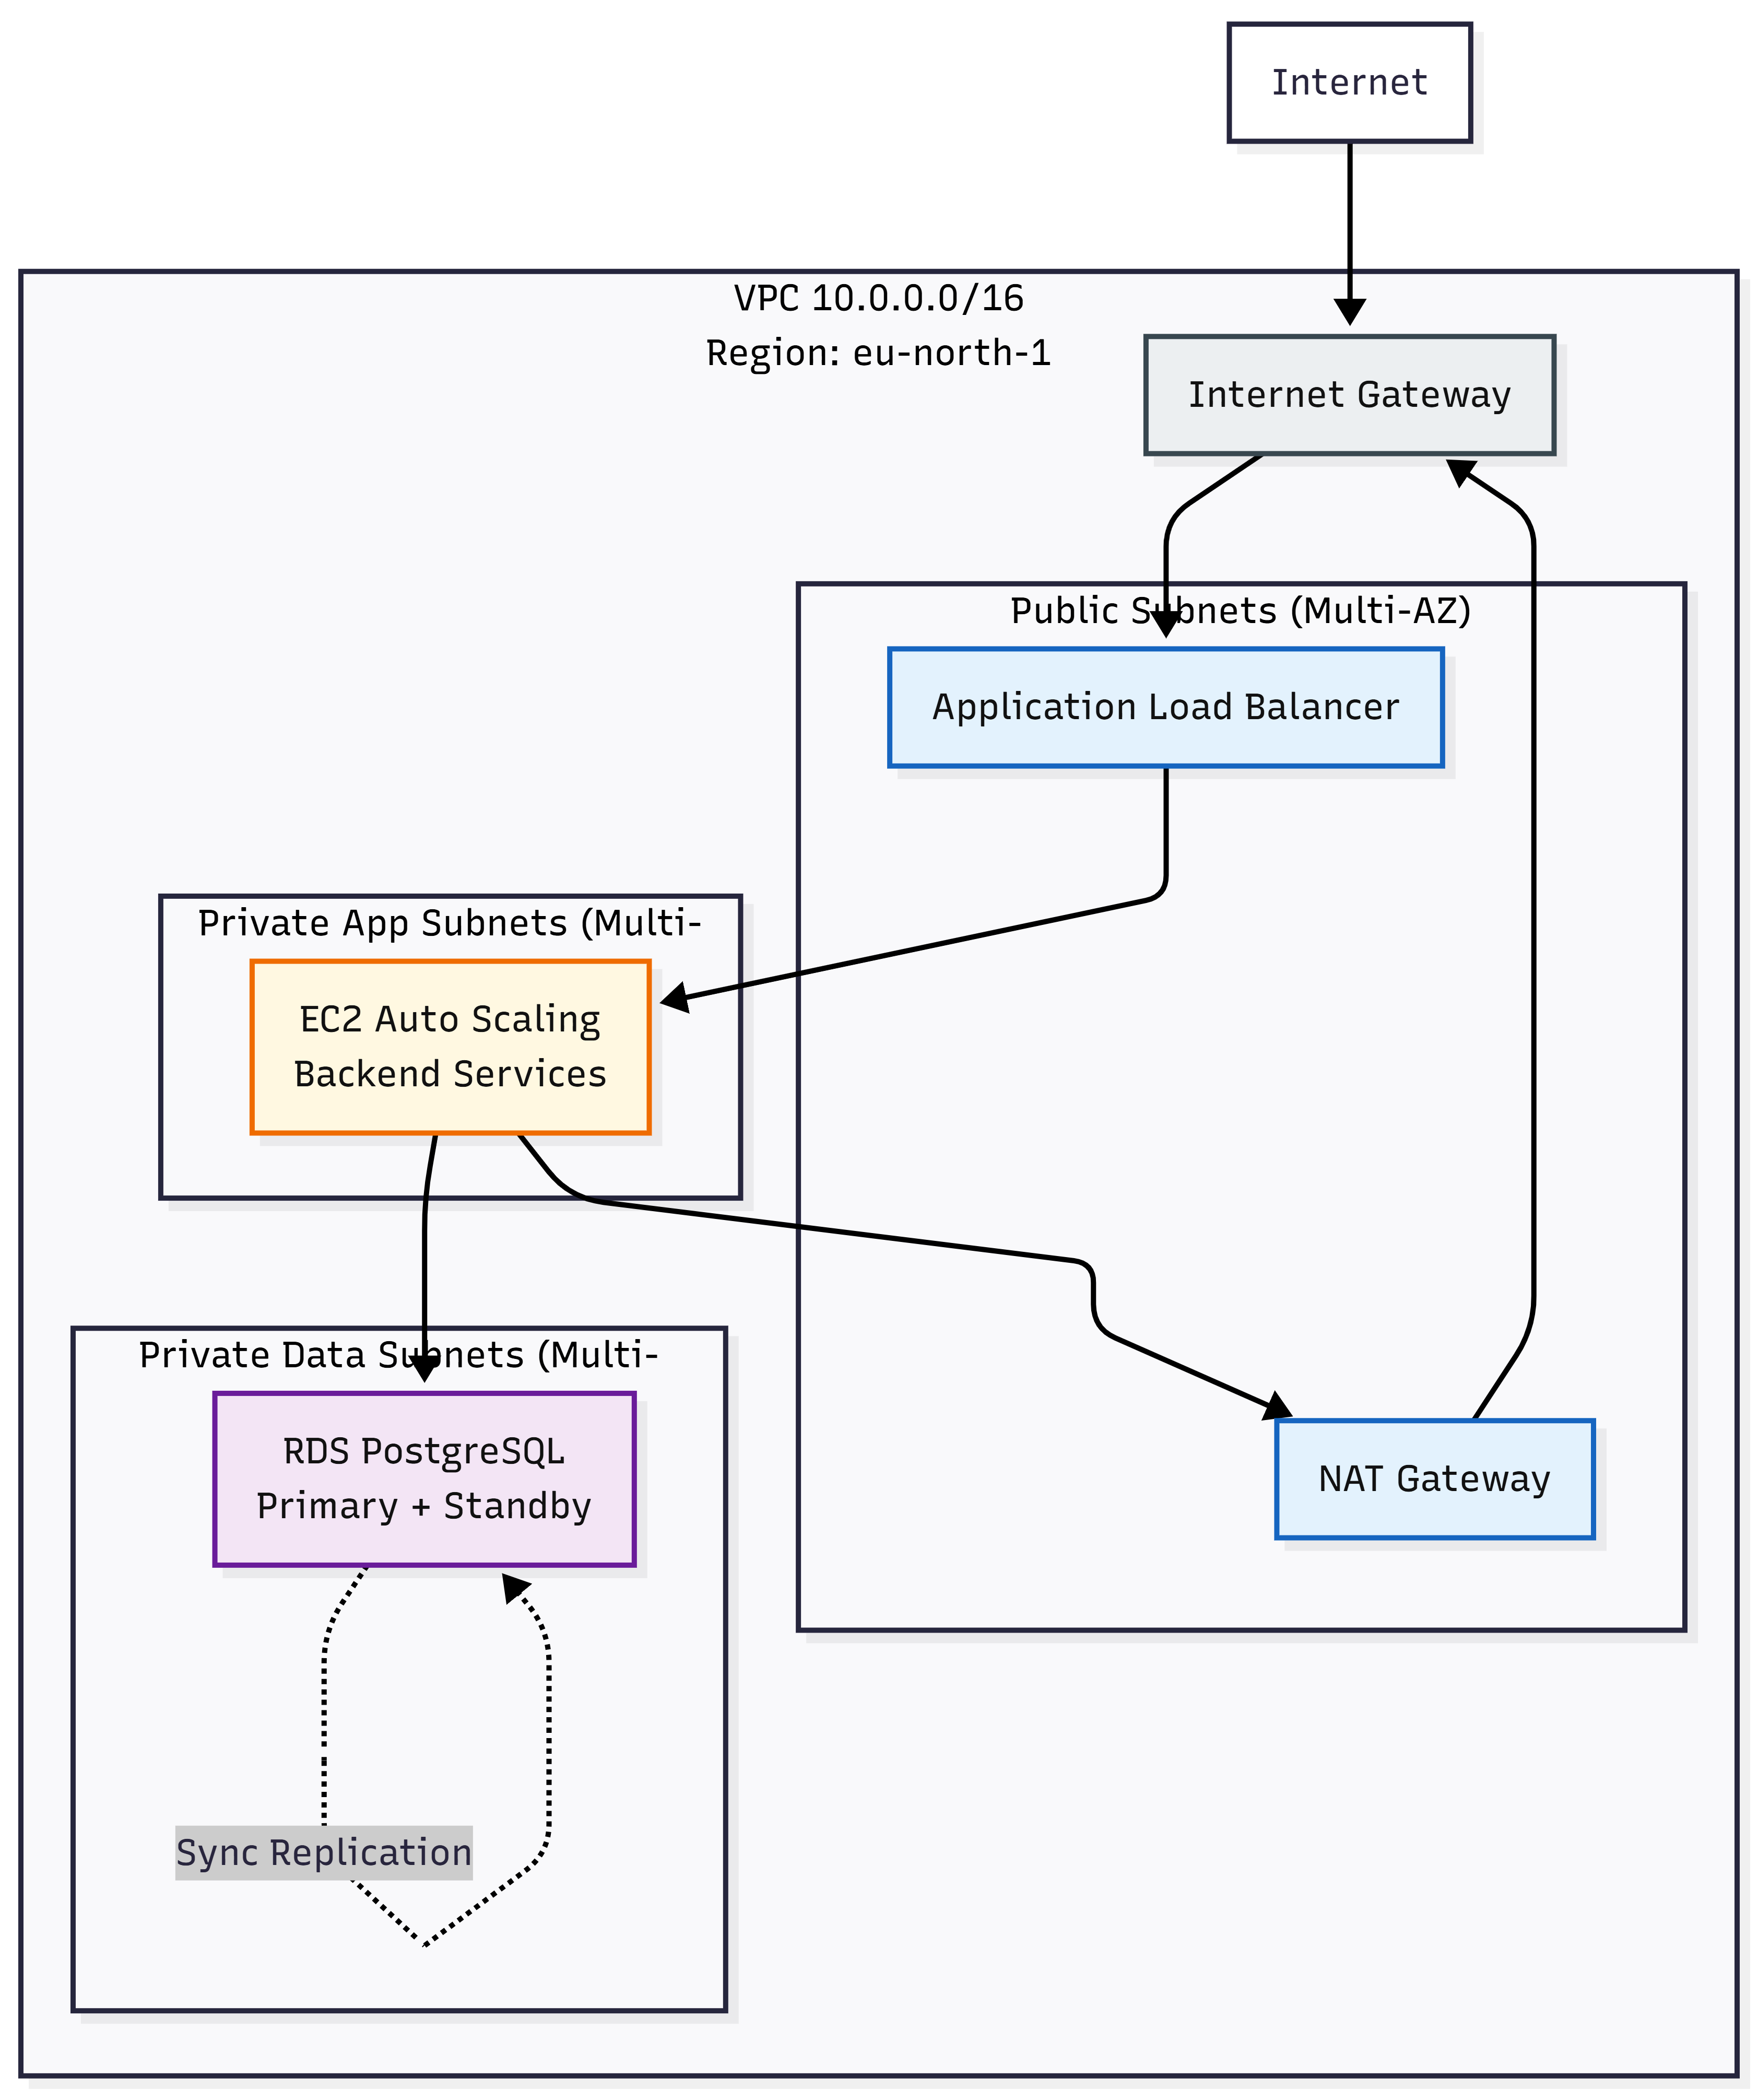








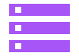

Network Topology & Data Flow
VPC Architecture
CIDR: 10.0.0.0/16
Public Subnets: ALB, NAT Gateway
Private App Subnets: EC2 Backend
Private Data Subnets: RDS PostgreSQL
Multi-AZ: eu-north-1a, eu-north-1b
Figure 2: VPC Subnet Architecture
Request Flow
User
CloudFront
ALB
Backend EC2
RDS/S3
External APIs
Figure 3: Chat Streaming Request Flow

Slide 5






Detailed Design - Component Specifications
Frontend
Technology Choices
Technology Stack
Instance
RDS vs Self-Hosted
Next.js 15.5.7, React 18, TypeScript 5
t3.medium (2 vCPU, 4 GB)
Automated backups, Multi-AZ failover
CSS Framework
Instances
EC2 vs ECS vs Lambda
Tailwind CSS
2-5 instances
Predictable performance for RAG
S3 vs EBS
Backend
61% cost savings ($4.30/month)
Framework
Instance
ALB vs NLB
FastAPI 0.104+, Python 3.11
t3.large (2 vCPU, 8 GB)
Layer 7 routing, SSL termination
Workers
Instances
5 workers per instance
2-8 instances
Database Layer
Database
RDS Instance
PostgreSQL 15
db.t3.medium Multi-AZ
Storage
Backup
100 GB gp3
7-day retention, Point-in-time
Vector Store
61%
Cost Optimization
Engine
Backend
Embeddings
ChromaDB
S3 Standard
Google AI (1536-dim)
S3 storage vs EBS-only

Slide 6









Reliability & Fault Tolerance
Failure Modes & Impact
Multi-AZ Deployment
EC2 instance failure
RDS primary failure
All critical components deployed across multiple availability zones
S3 vector store loss
External API failure
DDoS attack
Backend app crash
RDS synchronous replication for zero data loss
DB pool exhaustion
Vector store corruption
DB transaction failure
Authentication bypass
Automatic health checks and instance replacement
Network partition
NAT Gateway redundancy across AZs
Recovery Mechanisms
Auto-recovery
5-15 min RTO
Service Level Objectives
ASG replacement
5-10 min
RDS Multi-AZ failover
<60s RTO, 0 RPO
Availability Target
99.9%
Circuit breaker
5 failures, 60s timeout
P95 Latency (Normal)
<2s
P95 Latency (RAG)
<5s
Recovery Time Objective
<15min

Slide 7
















Scalability & Performance
Scaling Strategies
Frontend ASG
Performance Optimization
Horizontal Scaling (Primary)
Min / Max
2 / 5
Auto Scaling Groups
Instance
t3.medium
Connection Pooling
Stateless design (JWT)
5 connections/worker
ALB load distribution
Scale-out
CPU >70%
Async Processing
Vertical Scaling (Secondary)
Non-blocking I/O
Instance type upgrades
Memory >80%
Reserved Instances
CloudFront Caching
Backend ASG
1yr immutable, 1hr HTML
Capacity Planning
Database Optimization
Min / Max
2 / 8
Indexes, connection limits
Baseline
100 users
Instance
t3.large
2-4 instances
1,000 users
Scale-out
Peak
CPU >75%
Scaling Triggers
8 instances
10x traffic
Queue >100
CPU utilization
Spike
Memory usage
3-5 min scale-out
Scale-in
Request count
CPU <30% & Queue <20
Queue depth

Slide 8

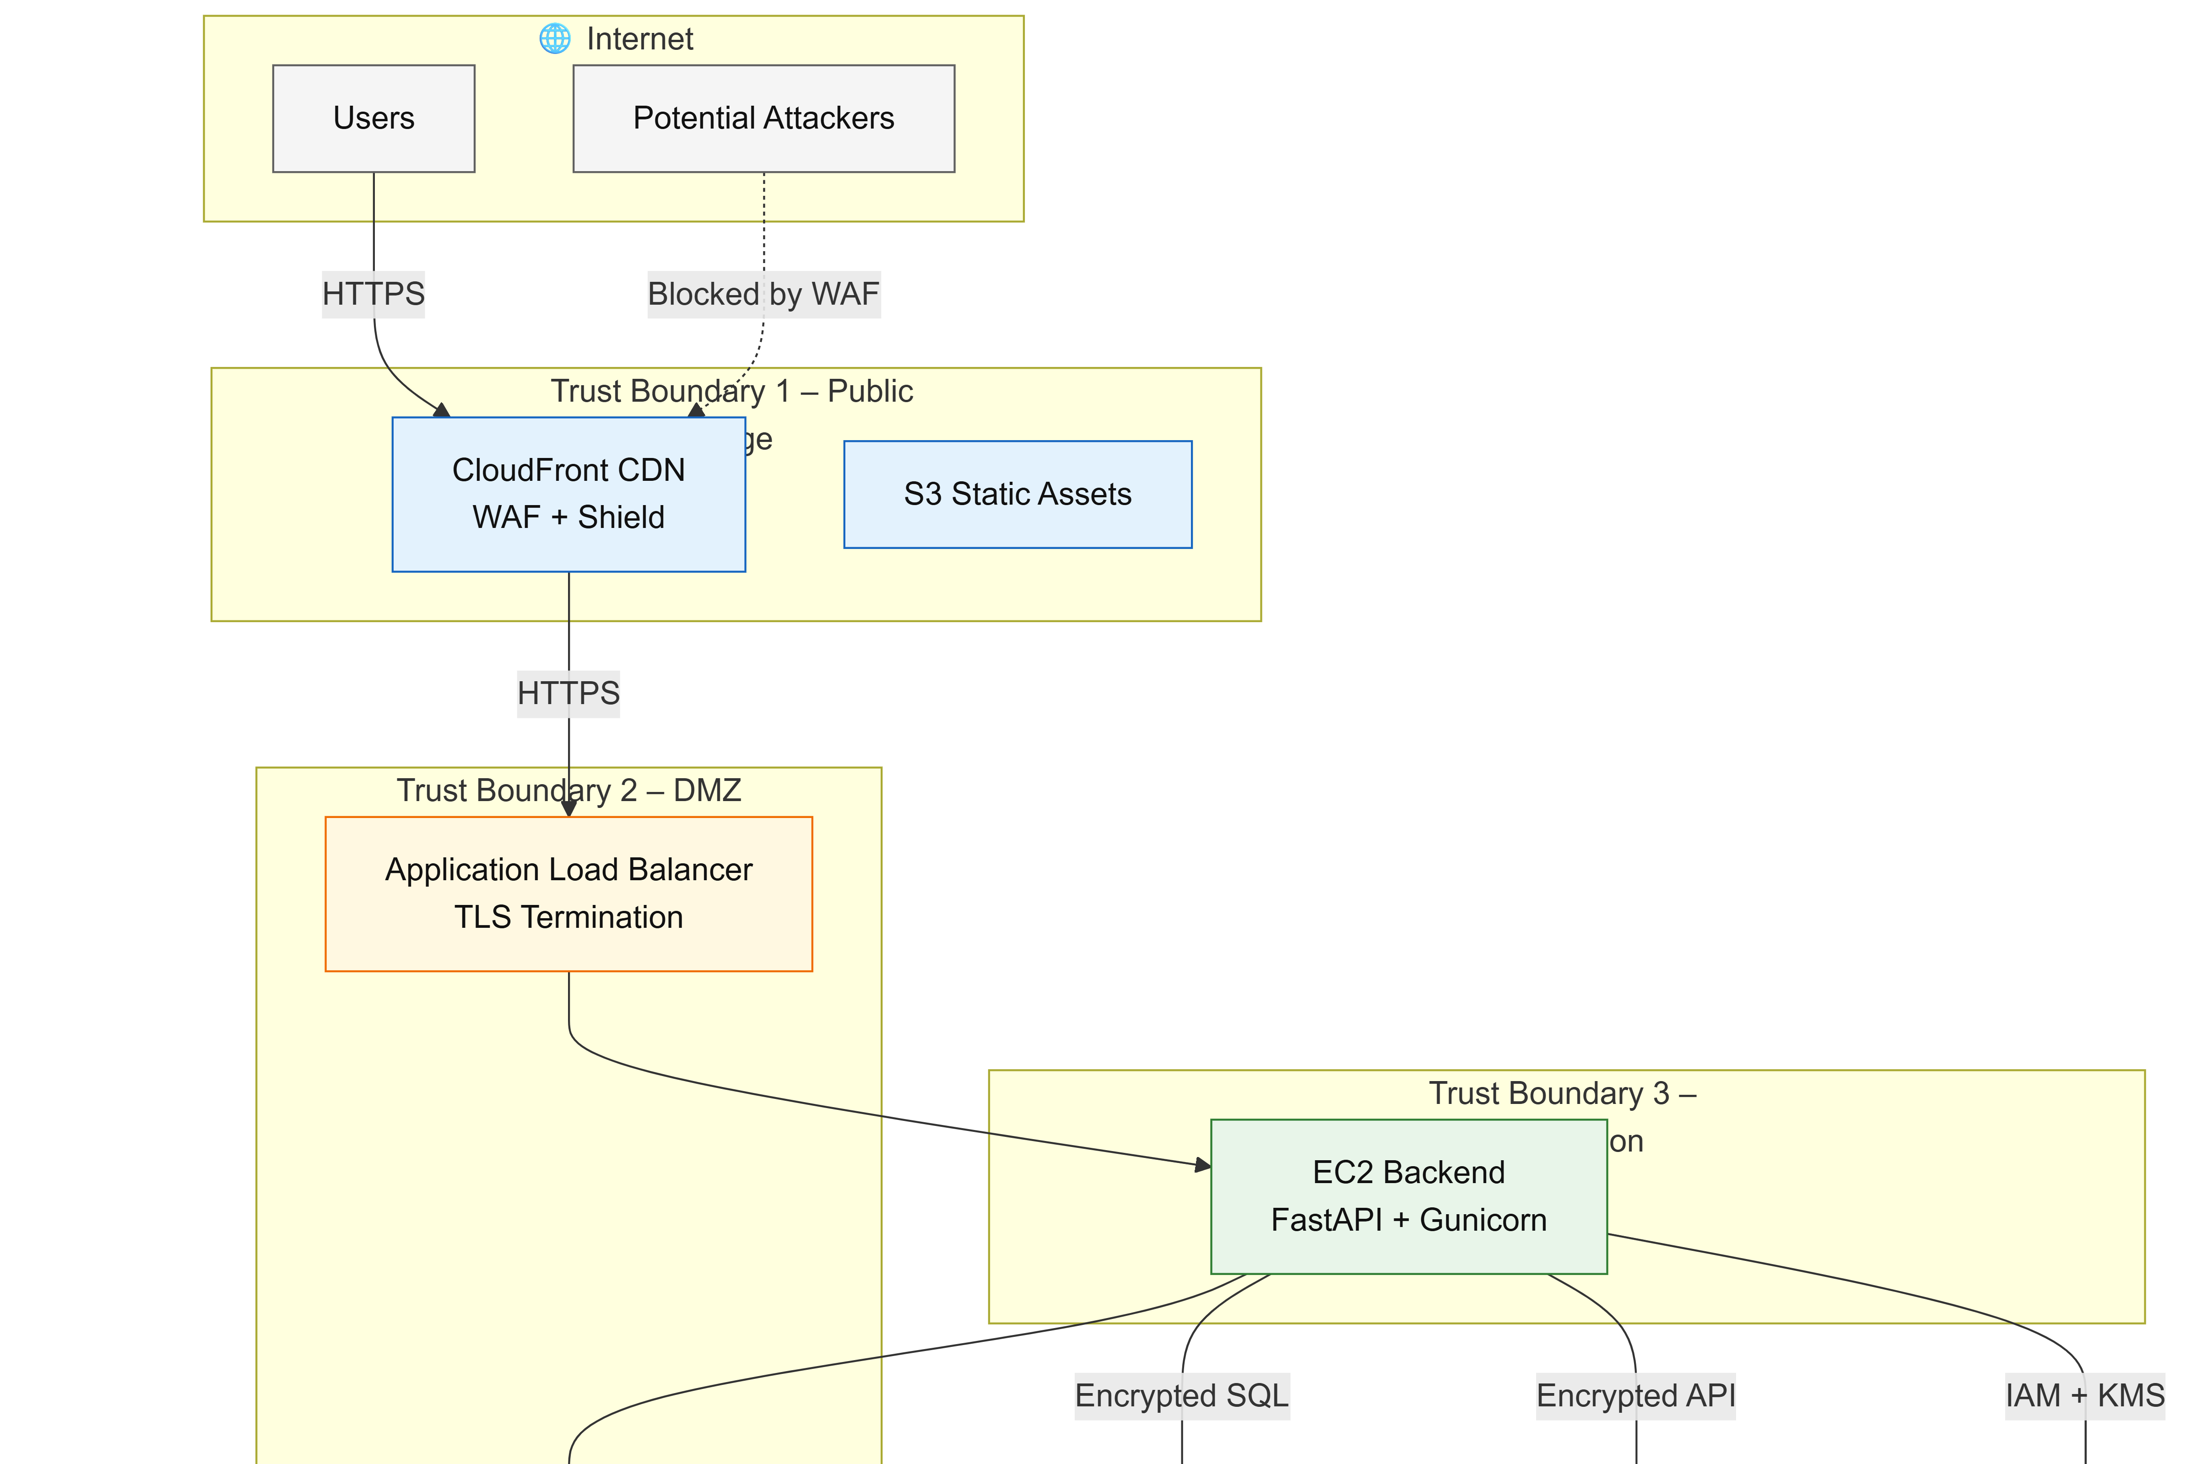


Security Design - Overview
Defense-in-Depth Layers
Security Architecture & Trust Boundaries
1
Network Perimeter: CloudFront, WAF, Shield
Public
DMZ
Private
2
Application: WAF rules, JWT, input validation
3
Infrastructure: VPC segmentation, security groups
4
Data: AES-256 at rest, TLS 1.2+ in transit
5
Identity: IAM roles, Secrets Manager, audit logging
Encryption Strategy
RDS
AES-256, TLS 1.2+
S3
SSE-KMS, HTTPS
EBS
KMS encryption
Secrets
KMS encryption
Authentication
JWT Token
256-bit secret
Expiration
30 days
Password Hashing
bcrypt (work 12)

Slide 9






























Security Design - Network Segmentation
VPC Architecture
eu-north-1a
eu-north-1b
Compliance Framework
10.0.0.0/16
GDPR Compliance
Public Subnets
Private App Subnets
Private Data Subnets
Encryption
Access controls
• ALB (HTTPS 443)
Data retention
EU data residency
• EC2 Backend
• RDS PostgreSQL
SOC 2 Controls
• NAT Gateway
• HTTP 8000 only
• Port 5432 only
Security
Monitoring
Audit logging
Controls
Security Groups
Network ACLs
Least privilege access
Additional protection layer
Deny-all default
Stateless rules
Port-specific rules
Subnet-level filtering
IAM & Access Control
RDS Multi-AZ
EC2 instance roles
No long-lived creds
Synchronous replication
<60s failover
Least privilege policies
Audit logging enabled
Zero data loss
7-day backups

Slide 10






Operational Plan - CI/CD Pipeline
CI/CD Pipeline Stages
CI/CD Pipeline Flow
1
Source Control
GitHub, PR reviews (2 approvals), branch protection
2
Build
Docker image, dependencies, linting
3
Test
Unit tests >70%, integration tests, security scans
4
Deploy Staging
Automatic (develop branch), smoke tests
5
Deploy Production
Manual approval, blue-green/canary, monitor 1h
6
Post-Deployment
Smoke tests, monitoring, rollback if error >5% or latency 2x
Blue-Green
Canary
Rolling
Zero downtime
Gradual rollout
Incremental update

Slide 11















Monitoring & Runbooks
CloudWatch Metrics & Alarms
Top Incidents & Resolutions
CPU Utilization
>80%
5 min
High Error Rate
Database Failure
Memory Usage
>85%
5 min
Check CloudWatch logs
Verify Multi-AZ failover
Error Rate
>5%
5 min
Verify external APIs
Check RDS metrics
Response Time
>2x
10 min
Rollback if code issue
Restore from backup
Activate circuit breaker
<60s automatic failover
DB Connections
>80%
max
Instance Unhealthy
DDoS Attack
Disaster Recovery
Check /health endpoint
Check traffic spike
Restart service
Review Shield alerts
RDS
S3
Testing
ASG auto-replace (5-10 min)
WAF rate limiting
7-day retention
Versioning enabled
Monthly drills
Review application logs
Escalate to security team
5-min RTO
Cross-region repl
Verify restores

Slide 12











Cost Estimate
Baseline Cost
Optimized Cost
Optimization Strategies
$475.23
$325-350
Reserved Instances
$63/mo
/month
/month
1-year term, 30% savings
100 users, 1,000 req/day
With optimization strategies
S3 Intelligent-Tiering
$1/mo
Automatic cost optimization
Cost Breakdown
Right-Sizing
$50/mo
Monitor and adjust instances
EC2 Frontend
$67.64
EC2 Backend
$144.47
NAT Gateway Opt
$36/mo
RDS (Multi-AZ)
$116.62
ALB
$22.00
Single NAT, VPC endpoints
CloudFront
$10.00
NAT Gateway
$72.00
S3 Storage
$5.00
Secrets Manager
$2.50
CloudWatch
$15.00
Data Transfer
$20.00
Cost Per User
Baseline
Optimized
$4.75
/user/mo
$3.25-3.50
/user/mo

Slide 13









Testing Strategy
Test Pyramid
Chaos Engineering
Security Testing
70%
Unit Tests
EC2 Termination
Penetration Testing
Individual functions/components
ASG replacement 5-10 min
OWASP Top 10, SQL injection, XSS
20%
Integration Tests
RDS Primary Failure
Vulnerability Scanning
API endpoints, DB operations
Multi-AZ failover <60s
Dependencies, Docker images, infrastructure
10%
E2E Tests
External API Failure
Complete user workflows
Circuit breaker, graceful degradation
Security Audits
Network Partition
Quarterly reviews, IAM audits, compliance
Partial availability, RDS failover
Load Testing Scenarios
Baseline
Peak
Pass Criteria
Metrics
Frequency
100 users, <200ms
1,000 users, <2s
• Unit tests >70%
• Latency <2s
• Unit tests daily
• Integration OK
• Error rate <1%
• Load tests weekly
Spike
Stress
• E2E paths OK
• Auto-scale <5 min
• Security audits quarterly
10x traffic, rapid scale
Exceed capacity, graceful degradation
Testing Philosophy: Comprehensive coverage, automated pipelines, continuous monitoring
Endurance Test
24-hour sustained load, no memory leaks

Slide 14








Risk Register
R1: Data Breach
CRITICAL
MED
R2: External API Failure
Key Mitigations
HIGH
MED
Encryption, IAM roles, WAF, network segmentation, CloudTrail logging, security audits
R1: Defense-in-depth encryption & monitoring
Circuit breaker (5 fails/60s), fallback responses, monitoring, retry logic, graceful degradation
R2: Circuit breaker & fallback mechanisms
R3: Reserved Instances & cost monitoring
R6: Multi-AZ failover & automated backups
R3: Cost Overruns
MED
MED
R4: Scalability Bottlenecks
2
4
2
HIGH
LOW
CRITICAL
HIGH/MED
LOW
Reserved Instances (30% savings), AWS Budgets, Cost Explorer, right-sizing, monthly reviews
Auto-scaling (2-8 instances), load testing, capacity planning, monitoring, performance optimization
Risk Monitoring
• Quarterly risk review meetings
• Update based on incidents & testing
• Critical risks escalate immediately
R5: Single Region Deployment
R6: Database Failure
MED
LOW
CRITICAL
LOW
R7: Compliance
R8: Personnel
Multi-AZ deployment, cross-region replication (optional), multi-region (future)
RDS Multi-AZ (auto failover <60s), automated backups (7-day), point-in-time recovery (5-min RPO)
HIGH
LOW
MED
LOW

Slide 15







Conclusion & Future Work
Key Achievements
Current Limitations
Future Enhancements
99.9% Availability
Single region deployment (eu-north-1)
3-6 MONTHS
Target achieved
• Multi-region deployment
Multi-AZ Deployment
Reserved Instances pending
• AWS X-Ray integration
<60s RTO, 0 RPO
Advanced monitoring (X-Ray) & caching (Redis) planned
• Redis caching layer
Defense-in-Depth Security
• GuardDuty & Reserved Instances
5 protection layers
Budget constraints limit capacity
6-12 MONTHS
Auto-Scaling Capability
External API dependencies
• ECS Fargate migration
2-8 backend instances
• Distributed vector database
• Advanced RAG techniques
Production Monitoring
Ready to Scale
• Read replicas for scaling
Comprehensive alerting
Cost Optimization
12+ MONTHS
Production-ready architecture designed for growth, security, and operational excellence
• Microservices architecture
61% savings achieved
• ML pipeline integration
• Voice & mobile support
99.9%
<60s
• Multi-cloud strategy
Availability
Failover

Slide 16













Team Reflection
Team Overview
Individual Contributions
Cloud Computing (SE-315) • BESE29-A
Abdullah
Muhammad Azfar
Abdullah
Architecture • Scalability • Security • Team Coordination
Design • Reliability • Risk Register
Muhammad Azfar
Muhammad Affan
Muhammad Hamza Haider
Muhammad Affan
M. Hamza Haider
Muhammad Muhad
Testing • Conclusion • Architecture Diagrams
Cost • Testing • Conclusion
Key Learnings
Muhammad Muhad
Comprehensive cloud architecture design
Operational Plan • Cost
Balancing cost, performance & security
Documentation & operational procedures
Systematic risk management
99.9%
5 Layers
<60s
Practical application of course concepts
Availability
Security
Failover
Thank You
Cloud Computing SE-315
BESE29-A
Questions & Discussion

